Slide 1

T
E
A
M
-
15
Social Editorial Collaborative Pattern Analytics

Slide 2

TABLE OF CONTENTS:
Abstract
Introduction
Goal of the Project
Objectives of the Project
Workflow
Proposed Methodology
About the Dataset
Implementation Results
Conclusion

Slide 3
ABSTRACT
Social Media is a collective terminology for websites, blogs, apps and applications that targets Collaboration, Interaction, Communication, Content-sharing and Awareness spreading.
One such social media platform that we are going to focus on is “GitHub” platform.
GitHub is one of the largest socialized coding platforms which provides developers an opportunity to integrate, meet and collaborate with other developers, coders, testers and share their works with one another through this platform.
Analysing the GitHub user collaboration & interaction data can reveal numerous hidden facts and features like the impact created by an author a.k.a editor in the domain of developers and learners by analysing the User Influence in GitHub Social Network.
The Main Objective of this project is to perform a Panoramic study of Collaborative Patterns in GitHub & focus on “Recommending Co-Editors/Co-Authors who have yet to collaborate to perform the best”.

Slide 4
INTRODUCTION
Social Network Analysis (SNA), termed as network science, is a general study of the social network utilizing network and graph theory concepts. It explores the behaviour of individuals at the micro-level, their relationships (social structure) at the macro level, and the connection between the two.
Going deep dive into the two major Social Media Platforms, in the case of Twitter and GitHub, Social Network Analysis can be used to analyze the relationships between users, their interactions, and their influence within the platforms.
For Twitter, SNA can be used to analyze the relationships between users based on their interactions such as follows, retweets, and mentions.
For GitHub, SNA can be used to analyze the relationships between users based on their contributions to open-source projects. This can include analyzing the contributions made by users to individual projects, as well as the connections between users who have worked on similar projects.

Slide 5
GOAL OF THE PROJECT
In this project GitHub API is utilized to access the GitHub Data and apply social network analysis techniques on the fetched data.
The tasks include constructing graphs, finding influential users and performing community detection on the GitHub user data.
The Outcome of the project is to develop a Simple Recommender System.
A recommendation system in social networks recommends users to "connect" with one another in some fashion. In the GitHub context, we will implement a recommender system that suggests Editors that should collaborate.

Slide 6
Objectives of the Project
Identifying and analyzing network structures: SNA can be used to identify and analyze the structure of networks on Twitter and GitHub. This includes identifying the nodes (users or repositories) and edges (follower relationships or collaborations) within the network, as well as analyzing the overall network structure (the degree of connectivity and the presence of clusters).
Identifying influential users: SNA can be used to identify users who are highly connected or who have a significant impact on the network.
Analyzing community structure: SNA can be used to identify and analyze communities within a network.
Predictive modelling: SNA can also be used for predictive modelling, such as predicting user behaviour or identifying potential collaborations. We will perform GitHub network analysis to identify potential Collaborations & also recommend the Co-Editors who have yet to collaborate & edit together in GitHub.

Slide 7

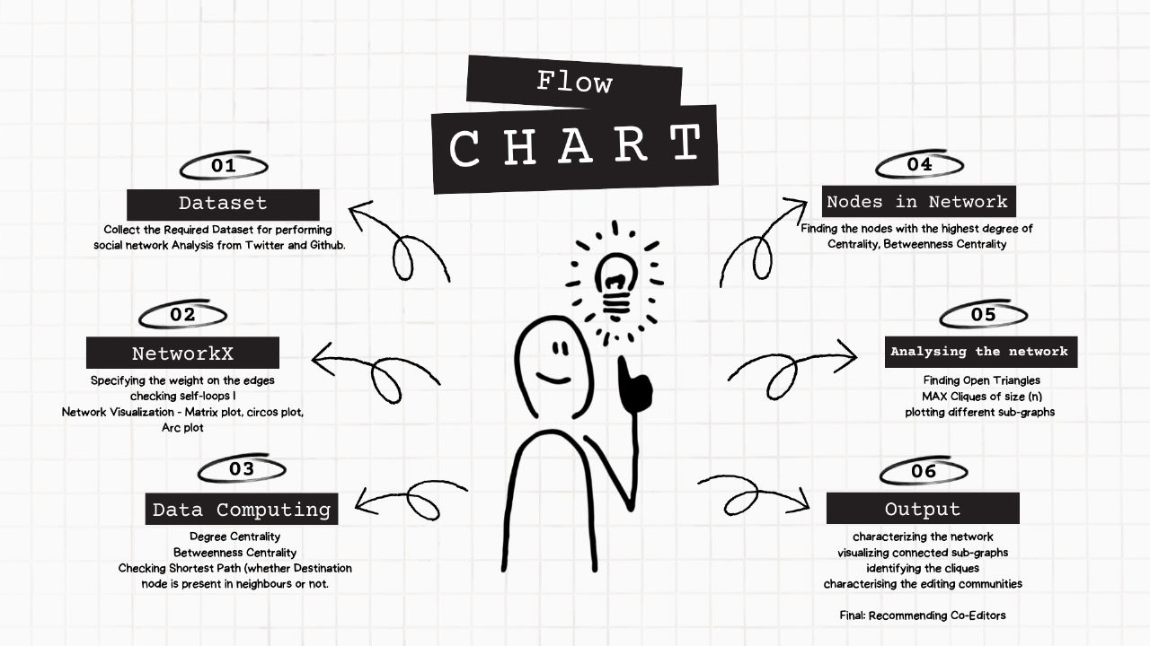
WORKFLOW

Slide 8
Proposed Methodology
Collect the required Datasets. The Datasets that we require for performing social network analytics is GitHub Dataset.
In order to Perform Network Analytics on GitHub Dataset, we first need to plot/draw the Network. Hence, the first task of the project is to Basic Network Creation using NetworkX Library
a. Understand the type of the Graph that has been occurred.
b. Specify the Weights on edges.
c. Check the presence of Self-Loops in the Graph.
d. Network Visualization – Matrix Plot, Circos Plot & Arc Plot.
Perform a detailed Analysis on the Network
PART-I Computing: Degree Centrality, Betweenness Centrality & Shortest Path
PART-II Analysing the Influential Power of the Nodes in the network
PART-III Analysing the Structure of the Network
PART-IV Implementing & Analyzing Graph Properties & Recommending Co-Editors who have yet to edit.

Slide 9
About The DATASET
The GitHub User Collaboration Network Dataset is a dataset that contains information about the collaboration between users on the GitHub platform.
GitHub is a popular platform for developers to collaborate on open-source projects, and this dataset provides insight into how users interact with each other on the platform.
The Dataset is made out of using GitHub’s API to identify the Social Connections in Pull request & Issues Comments. Social Network Connections are between the Author of the pull request/issue & the author of the Comments.
It contains data on over 36 million users and 2 billion interactions, making it one of the largest publicly available datasets on GitHub collaboration.
This dataset has many potential applications, including the analysis of user behaviour on the platform, the prediction of future collaborations between users, and the identification of influential users within the GitHub community.
The dataset was created by researchers at the University of Notre Dame.

Slide 10
Implementation Results
Drawing The Network using NetworkX Library.
Visualising Sub-Graph of the Network.

Slide 11
Implementation Results
VISUALISATION OF THE NETWORK
Matrix Plot
Circos Plot
Arc Plot
Arc Plots are a transformation of the node-link diagram layout, in which nodes are ordered along one axis of the plot, and edges are drawn using circular arcs from one node to another.
If the nodes are ordered along the rows and columns, such that neighbours are listed close to one another, then a matrix plot can be used to visualized clusters, or communities, of nodes.
In Circos Plot, Nodes are ordered around the circumference in some fashion, and the edges are drawn within the circle

Slide 12
Implementation Results
Degree Centrality Distribution
Scatter Plot between Degree & Degree Centrality
Degree Distribution
Degree Centrality
Inference: Given Similarities of their Histograms, we can see a perfect correlation between the centrality distribution and the degree distribution.

Slide 13
Implementation Results
Betweenness Centrality
Scatter Plot between Degree Centrality & Betweenness Centrality
Betweenness Centrality of the nodes
Betweenness Centrality Plot

Slide 14
Implementation Results
Maximal Cliques: One naive way of identifying communities
Identifying Maximal Cliques
All Maximal Cliques of Size “n”

Slide 15
Implementation Results
Sub-Graphs
Plotting Random Sub Graph using Erdos Renyl (ER) Method
Visualising Sub-Graph Extracting all the Adjacent Nodes of a particular Node.

Slide 16
Implementation Results
Sub-Graphs- I & II
Extracting subgraph of graph “G” with only the nodes of interest & its neighbours.
Extracting nodes that have a particular metadata property ‘Occupation’ as ‘Celebrities’ alongside of their neighbours.

Slide 17
Developing A Recommender System
Developing a Recommender System that recommends Co-editors who can collaborate to edit together.
The Process involves:
i. Analysing Graph Properties by Characterising the Network.
ii. Identifying Strongly Connected Components
iii. Identifying Cliques
iv. Finding Important Collaborators
v. Characterising Editing Communities
vi. Recommending Co-Editors who have yet to edit collaboratively.

Slide 18
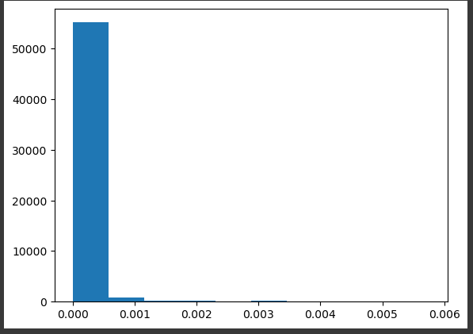
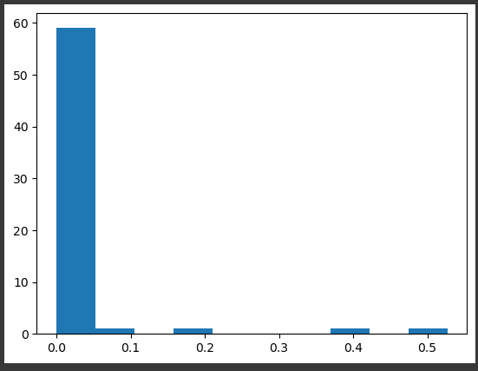
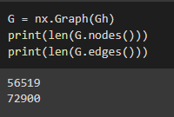
i. Analysing Graph Properties by Characterising Network
Identifying Number of Nodes & edges in the Network.
Degree Centrality Distribution of GitHub Collaboration Network.
Betweenness Centrality of GitHub Collaboration Network.

Slide 19
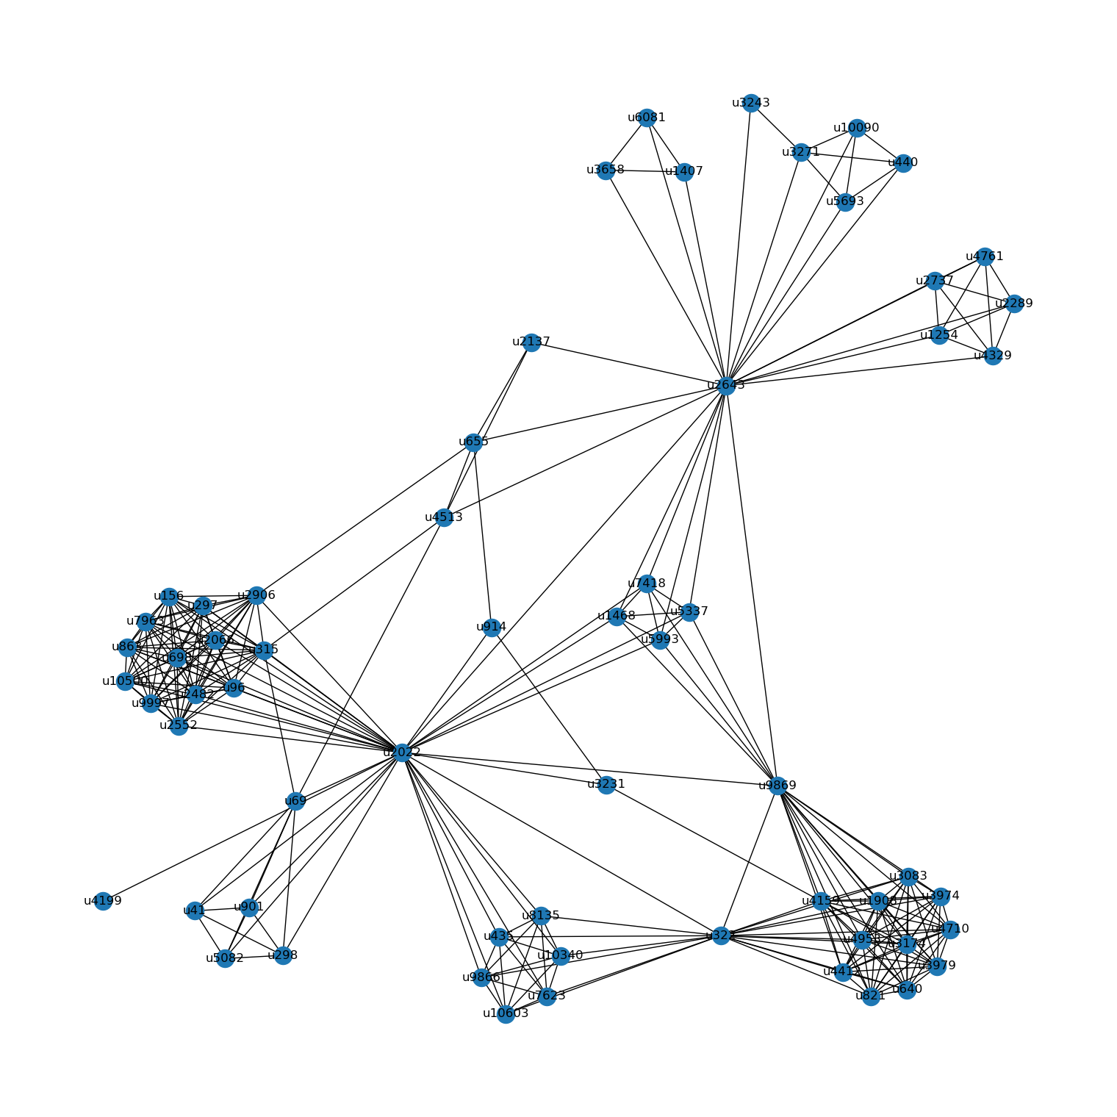
ii. Visualizing Largest connected components
MatrixPlot visualization
MatrixPlot Visualisation of the largest connected component subgraph, with authors grouped by their user group number.

Slide 20
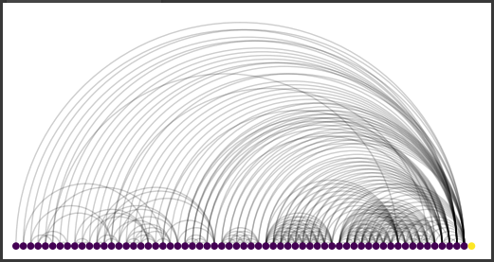
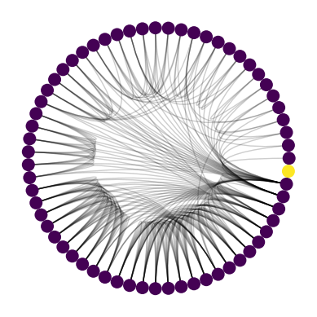
Visualizing Largest connected components
ArcPlot:
ArcPlot of the GitHub collaboration network, with authors sorted by degree
Circos Plot:
CircosPlot of the network, again, with GitHub users sorted by their degree, and grouped and colored by their 'grouping' key.

Slide 21
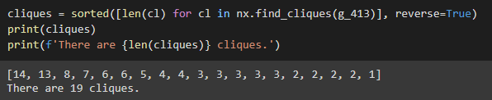
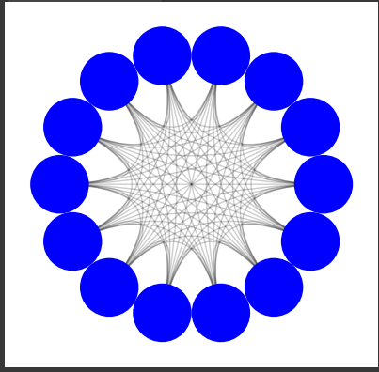
iii. Finding Cliques
Finding Number of Maximum Cliques in the network
Finding & Plotting a particular Maximal Clique

Slide 22
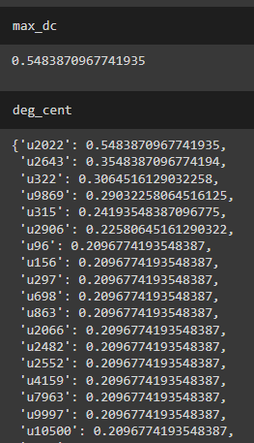
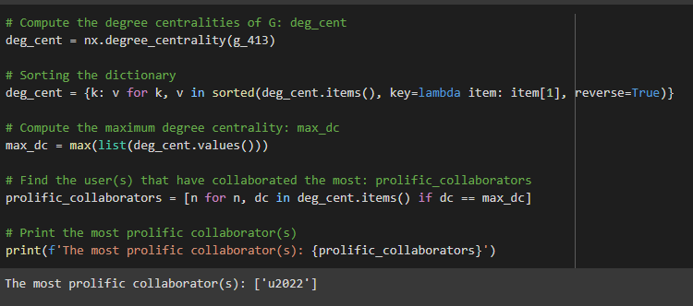
iv. Finding Important Collaborators
Most Prolific Collaborator:
The Most Prolific Collaborator is identified to be “U2022”
Identifying degree Centrality:
Identifying maximum degree centrality & degree of each Editor/User.

Slide 23

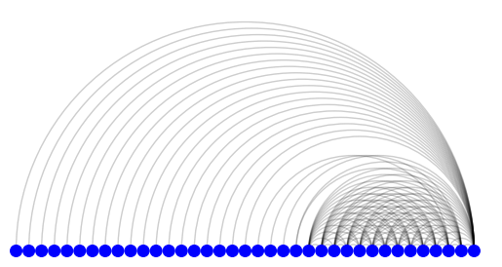
Degree Centrality in Largest Maximal Clique:
Arc Plot to screen each node’s degree centrality of the subgraph created from largest maximal clique

Slide 24
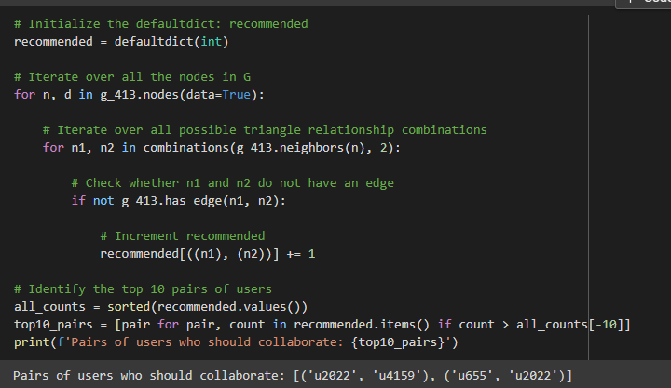
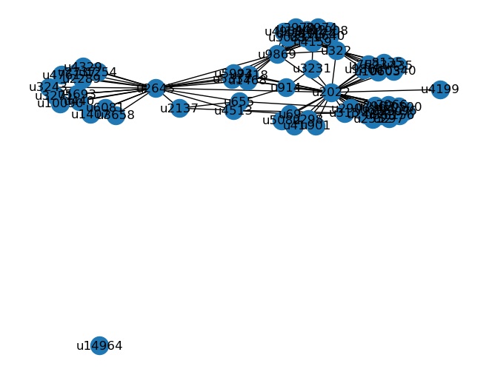
vi. Recommending Co-Editors Who Have Yet to Edit Together
Conclusion: It can be concluded that the Pair of Users who are yet to collaborate are : (“U2022”, “U4159”) & (“U655” & “U2022”).

Slide 25
CONCLUSION
In this project we have visualised the basics of Network & performed Network Analysis.
Identified Most Important Users in GitHub User Collaborative Network
Identified Largest Communities of the Collaborators.
Built a Collaboration Recommendation System.

Slide 26


Team-15
K.Vigneswar Siddu – 19MIA1013
D. Nikkitha – 19MIA1043
N. Shreya – 19MIA1044

